Slide 1


Exploiting Multi-Source Data for Adversarial Driving Style Representation Learning
Zhidan Liu; Junhong Zheng; Zengyang Gong; Haodi Zhang; Kaishun Wu
Presenter : Junhong Zheng
Shenzhen University, China

Slide 2

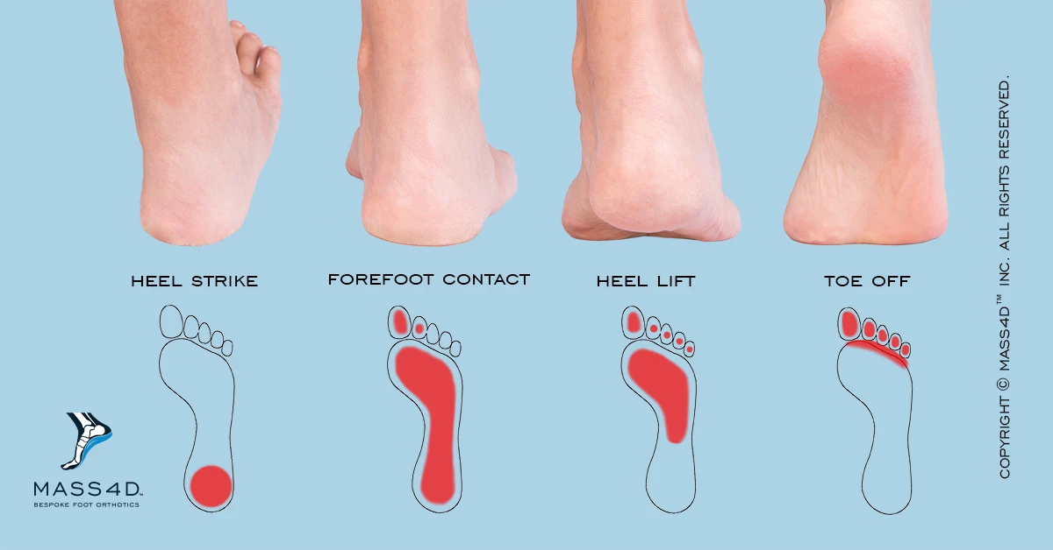
Driving style
What is driving style?
It is believed that each driver has a distinguishable pattern of driving.
Why learning a good driving style representation is useful?
Driving assessment, autonomous driving and so on.

Slide 3


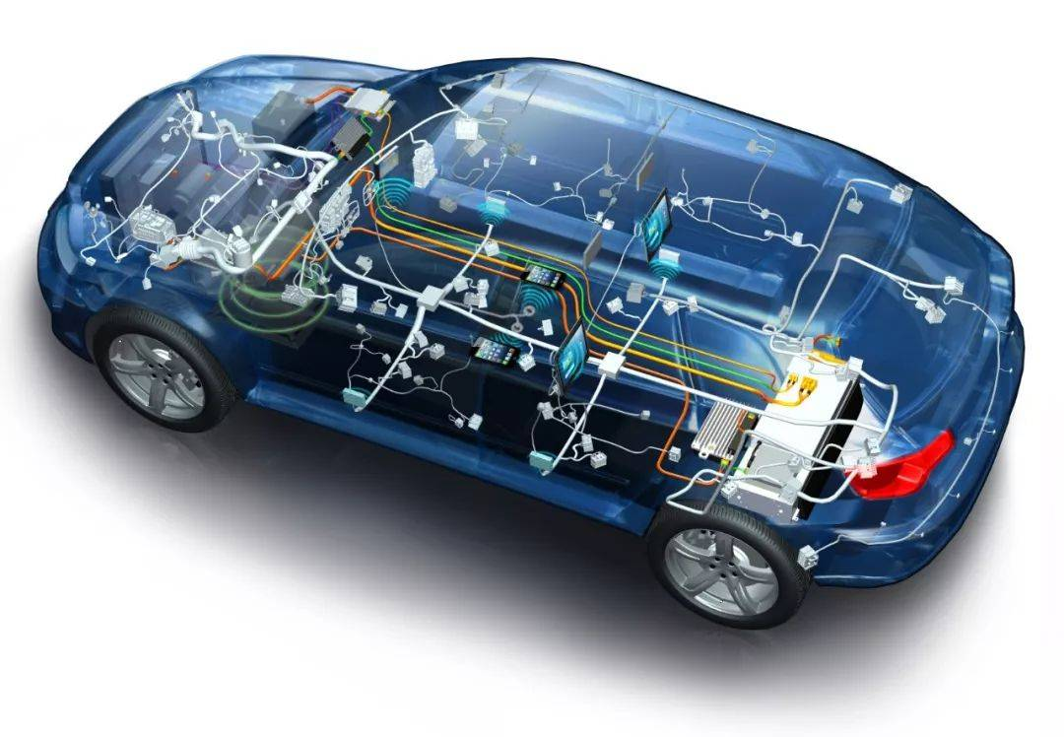
Existing works
Exploiting multiple sensors data
Deficiencies: Difficulty in collecting data and extra devices are expensive

Slide 4
Existing works
ARNet
Dong et al. [2017] propose an autoencoder regularized neural network for driving style representation learning, merely from raw GPS data.
T2INet
Kieu et al. [2018] represents a GPS trajectory as the multi-channel images that capture both geographic and driving behavior features using a sequence of convolution layers.
Deficiency: Did not consider driving context information
[1] Weishan Dong, Ting Yuan, Kai Yang, Changsheng Li, Shilei Zhang: Autoencoder Regularized Network For Driving Style Representation Learning. IJCAI 2017: 1603-1609
[2] Tung Kieu, Bin Yang, Chenjuan Guo, Christian S. Jensen: Distinguishing Trajectories from Different Drivers using Incompletely Labeled Trajectories. CIKM 2018: 863-872

Slide 5

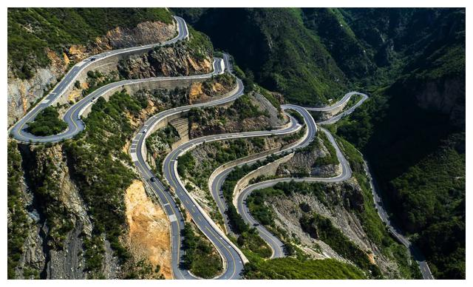
Motivation
Motivation
The driving context information affects the driver's driving activities. Thus, we not only use GPS data to represent the driver's steering and speed control, but also employ multi-source data as input to represent driving context information, e.g., road condition, geographic semantic, and traffic condition.
More careful
Compared

Slide 6
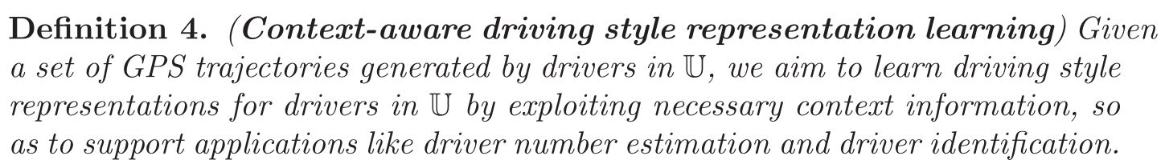
Problem statement
Challenges
Data sparsity
Balanced integration of features from GPS data and contextual information

Slide 7
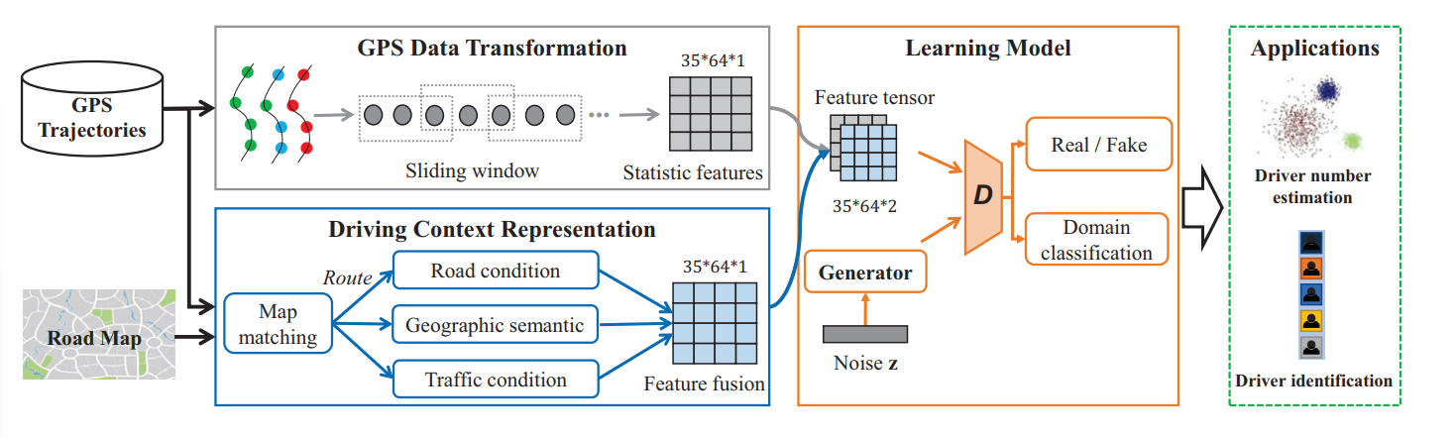
Our proposal: Radar
We present Radar: adversarial driving style representation learning approach

Slide 8
GPS data transformation
Deriving statistic features to represent driver's habits of steering and speed control
Basic features：speed norm, acceleration norm, and angular speed...
Seven statistics：mean, minimum, maximum, 25%, 50% and 75% quartiles, and standard deviation
...
w₁
w₃
basic features
...
w₂
w₄
statistical features
Fig. Sliding time windows generation
Fig. Statistical feature generation

Slide 9
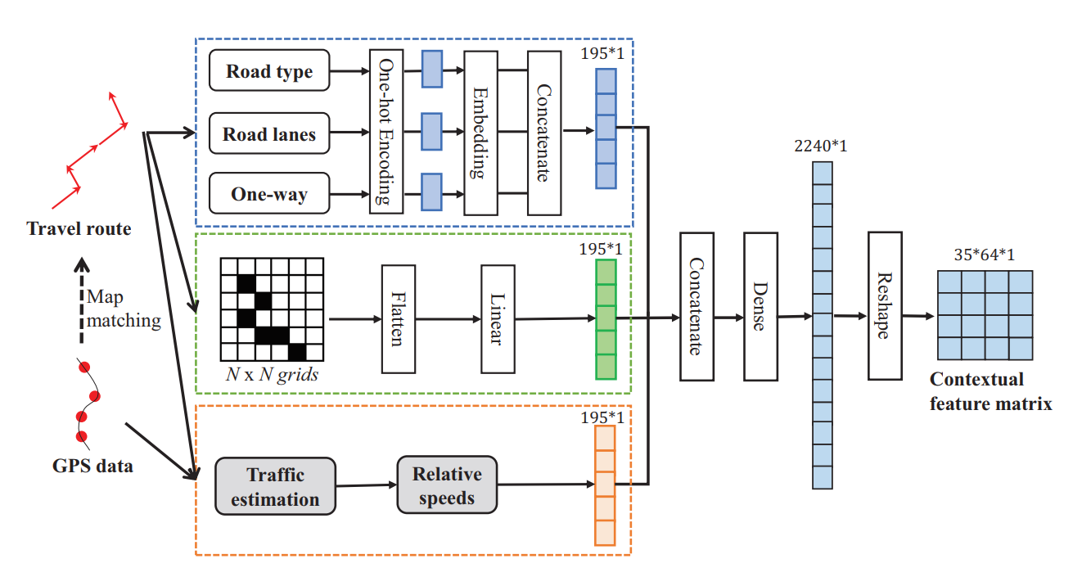
Driving context representation
We particularly consider the three contexts of road conditions, geographic semantic, and traffic conditions.
Fig. The framework of driving context representation module

Slide 10
Driving context representation
Road condition
We consider the following 3 types of road condition features:
Road types
Number of lanes
Oneway
One-hot coding
road types
lanes
oneway
Fig. Road condition representation

Slide 11
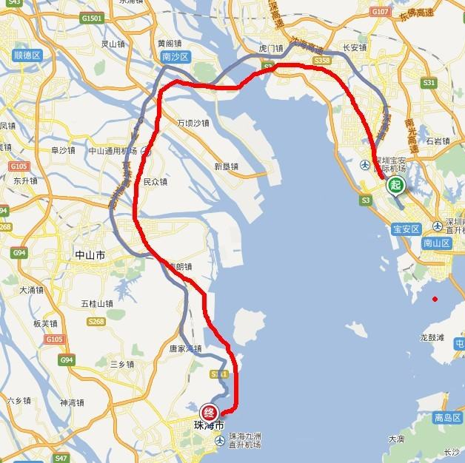
Driving context representation
Geographic semantic
We divide the geography into grids. If the trajectory crosses the grid, it will be marked as 1, otherwise will be 0.
Fig. The black elements have value 1

Slide 12
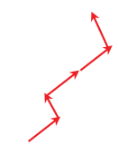
Driving context representation
Traffic conditions
We classify all GPS records to road segments according to map matching.
We calculate each segment average travel speed of a specific time slot.
We calculate the relative speeds, which indicate traffic conditions.
Map matching
Average
speed
Relative
speeds
GPS data
Travel route
[3] Yin Lou Chengyang Zhang Xing Xie Yu Zheng Wei Wang Yan Huang, Map-Matching for Low-Sampling-Rate GPS Trajectories, 2009

Slide 13
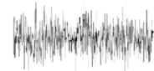
Learning model
Generative Adversarial Networks (GAN): A discriminator is trained to discriminate real samples from fake ones, while a generator tries to generate fake training data to fool the discriminator.
Generator
Noise
Discriminator
“Real”
Images
“Fake”
Fig. Traditional GAN setup
[4] Ian J. Goodfellow, Jean Pouget-Abadie, Mehdi Mirza, Bing Xu, David Warde-Farley, Sherjil Ozair, Aaron Courville, Yoshua Bengio. Generative Adversarial Networks. arXiv 2014

Slide 14
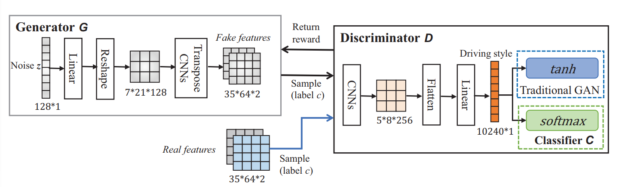
Learning model
Semi-supervised GAN(SGAN)
In SGAN, discriminator D can also act as a classifier C to classify each input sample into one of the predefined (k+1) classes, where k is the number of classes and the additional class label is added for a new“fake”class.
Fig. The framework of learning model
[5] Adrian Spurr, Emre Aksan, Otmar Hilliges: Guiding InfoGAN with Semi-supervision. ECML/PKDD (1) 2017: 119-134

Slide 15

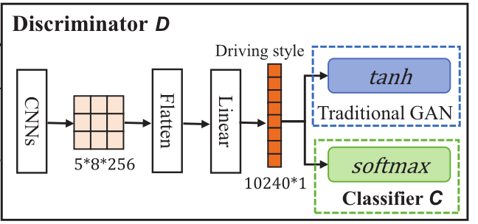

Learning model
Discriminator D (and classifier C)
Unsupervised mode:
Goal 1: maximize the score for real samples and minimizing it for fake ones. We achieve this objective by minimizing L^{(D)}, which is defined as follows:
Supervised mode:
In this mode, discriminator D acts as classifier C to complete a multi-class classification problem.
Goal 2: C should correctly classify it as class c. We aim to minimize the classifier loss L(C) , which is defined as follows:
Fig. The framework of Discriminator D

Slide 16

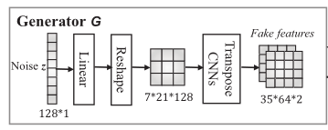
Learning model
Generator G
Goal 3: aims to find the parameterized conditional distribution G(z,c ,θ_{g}) that is close to the real distribution p_{r}(x). We train G by minimizing loss L(G) expressed as:
Fig. The framework of Generator G

Slide 17
Experimental setup
Dataset:
GPS trajectory dataset:
1.3 billions GPS records from 10000 drivers in Shanghai city, China.
Road map from OpenStreetMap
Baseline:
ARNet [1]
T2INET [2]
Radar-C only takes the statistic features as input to compute driving style representations
Benchmark applications:
Driver number estimation
Driver identification
[1] Weishan Dong, Ting Yuan, Kai Yang, Changsheng Li, Shilei Zhang: Autoencoder Regularized Network For Driving Style Representation Learning. IJCAI 2017: 1603-1609
[2] Tung Kieu, Bin Yang, Chenjuan Guo, Christian S. Jensen: Distinguishing Trajectories from Different Drivers using Incompletely Labeled Trajectories. CIKM 2018: 863-872

Slide 18
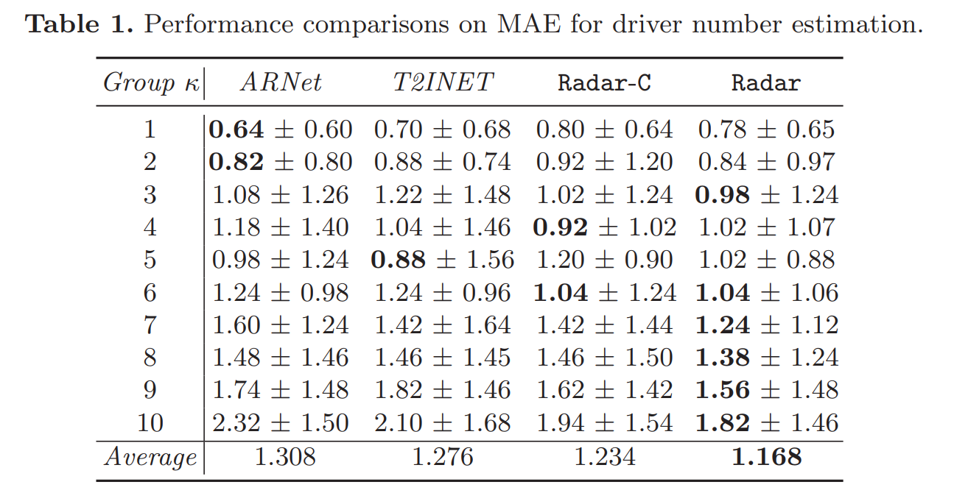
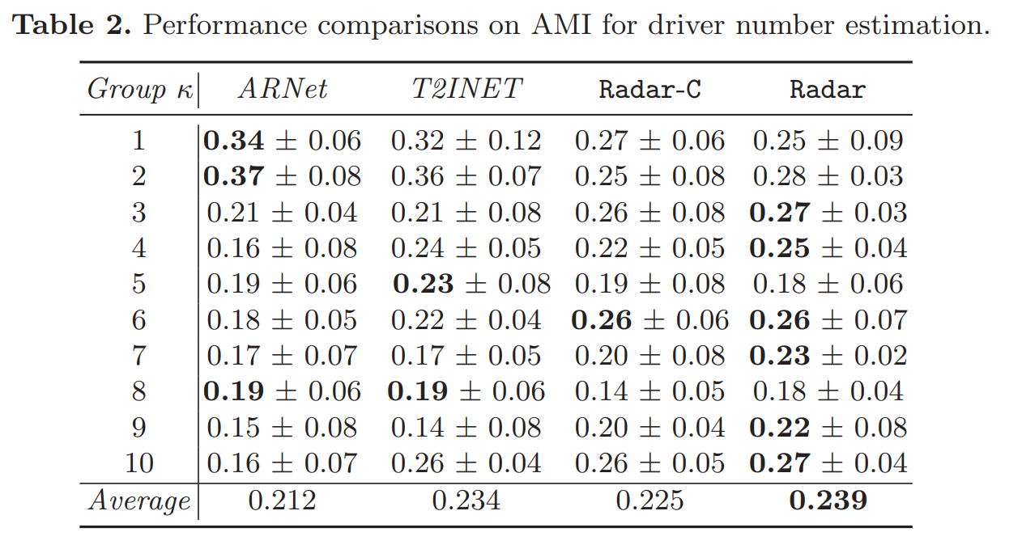
Driver number estimation
This application aims to estimate the number of drivers from a set of anonymous trajectories.
Metrics
Mean Absolute Error (MAE).
Adjusted Mutual Information score(AMI).

Slide 19
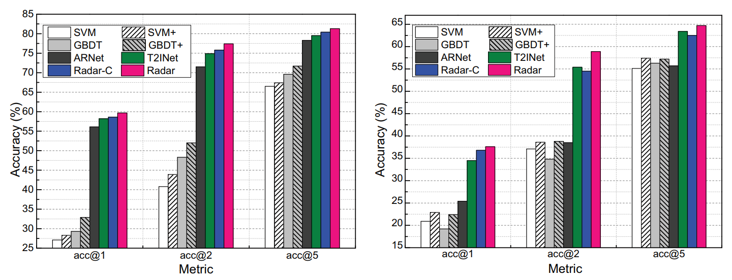
Driver identification
The driver identification problem aims to identify the driver of a given unlabeled trajectory.
Metrics
Accuracy @ n
Fig. Performance comparisons on Top-n accuracy with the long trajectories.
Fig. Performance comparisons on Top-n accuracy with the short trajectories.

Slide 20
Conclusion
We present an adversarial driving style representation learning approach – Radar.
In addition to summarizing statistic features，Radar also extracts contextual features from three aspects of road condition, geographic semantic, and traffic condition.
Radar outperforms state-of-the-art approaches on two benchmark applications.

Slide 21

2021
Thank You

